Slide 1
UMKC HACKTHON SPRING-2015
Pavan Kumar ,Bollaram
Lakshmi Priyanka
Preetham Kumar,Danaboina
Vara Prasad Reddy,Jaggu

Slide 2
Use case: Youtube v3 Ranking System Based on Object Search
Key features:
Login functionality with email address and a pre –assigned word.
Forgot password option.
To search videos by a keyword.
Sorting the videos by user’s interest.

Slide 3
YouTube Video Search
This Web Application allows the user to search the videos.
At first the user has to sign up using username, password and e-mail id.
After the user enter his login credentials the application validates user. If the user is valid one then he is redirected to the dashboard of the application where he can search for the videos.

Slide 4
If the user submits the wrong password for the three consecutive times then the user is disabled for login.
Forgot password option enables the user to login into application by validating the security question displayed.
Then he may successfully logs in even if he is not sure of his password entered.
Next, he is redirected to the search page where the user is provided with an search option to search videos.
Even, he can sort the search results by relevance, most popular, etc ***

Slide 5
Implementation
Login functionality is implemented using REST API’s which were implemented in visual studio
We developed this application by using the Youtube API v3 integrating it with our application using Ajax functionality
Videos were rendered to dashboard screen with additional meta data
Videos can be sorted according preferences mentioned on the screen
Sorting preferences are based on supporting functionality of Youtube API

Slide 6
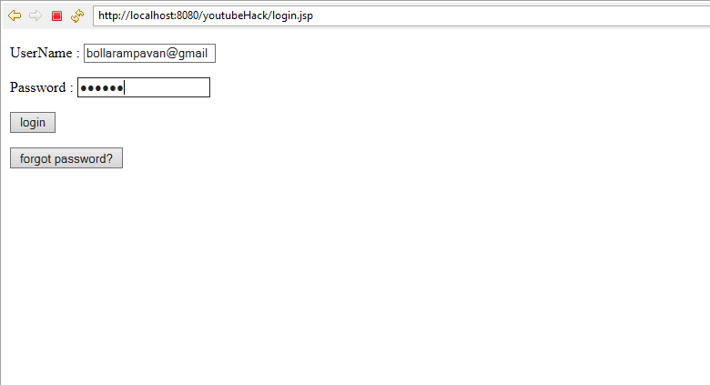
Application screen shots
Login Screen

Slide 7
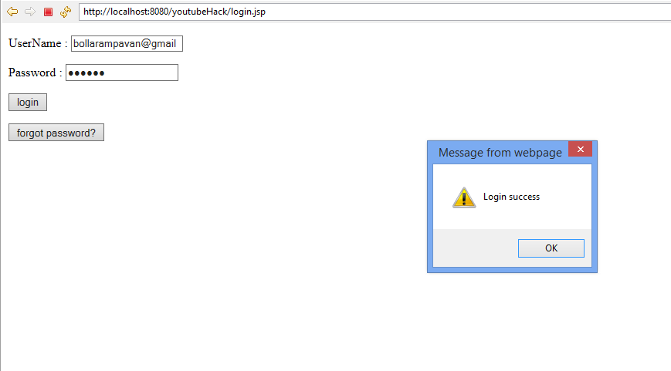
Login success

Slide 8
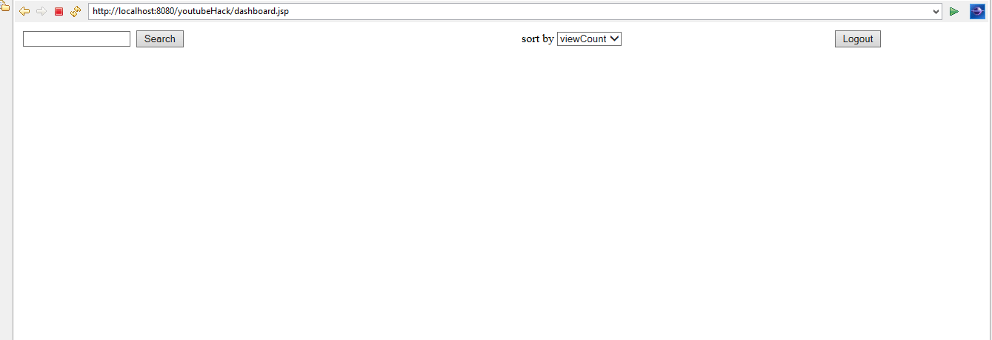
Dashboard Screen

Slide 9
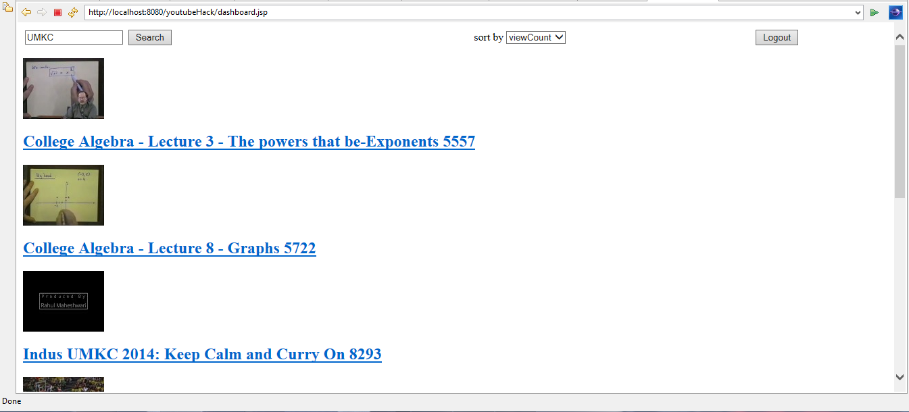
Search Object : UMKC Sort by :View Count

Slide 10
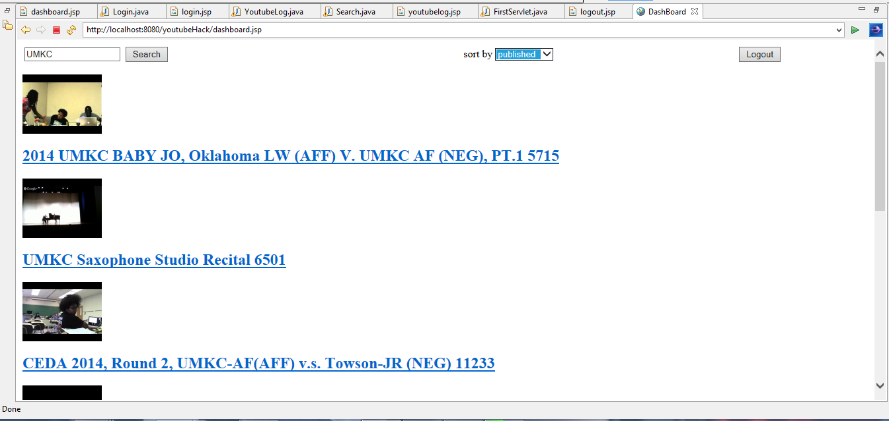
Search Object : UMKC Sort by :Published

Slide 11
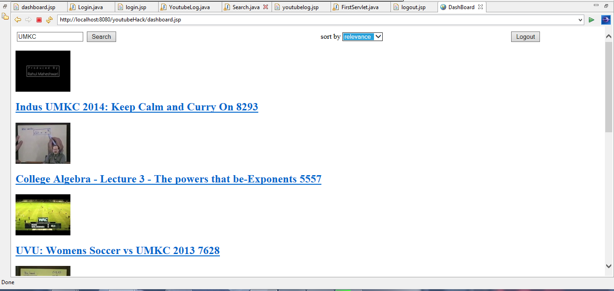
Search Object : UMKC Sort by :Relevance

Slide 12
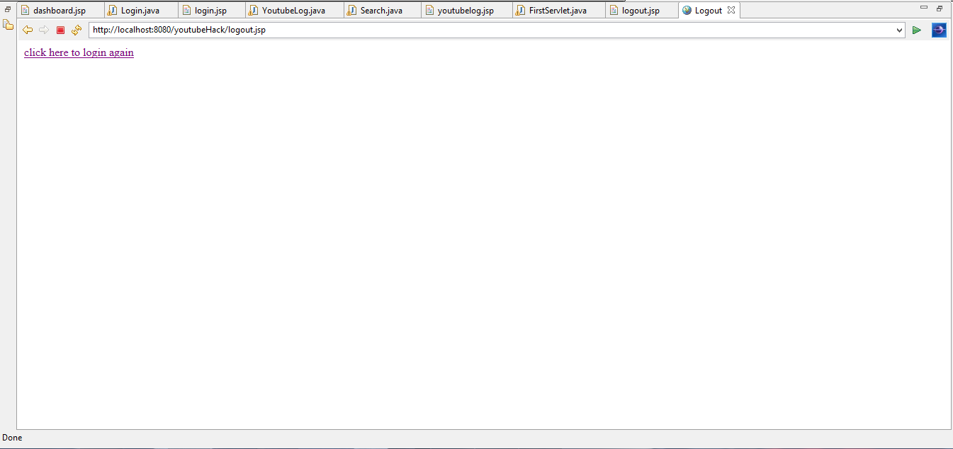
Log out

Slide 13
Login Screen Again

